Slide 1

BOOK STORE
BY SHUBH (RA1911042010124) &
BY SHUBH AGARWAL (RA1911042010122)

Slide 2
Introduction To Bookstore
The Internet has been favored by more and more people for its high efficiency and richness, and e-commerce has emerged. The online bookstore is a form of e-commerce and book sales industry in one form, it has many advantages, such as: Bookstore size is relatively small, cost savings; transaction activities can be anytime, anywhere, improve service efficiency, The information is complete, more convenient retrieval , the new book information on the new, consumers can see in a timely manner, trading activities can be launched immediately, so online bookstore in today's era of development is extremely rapid. Online bookstore system is the main function of the trading platform for the site, consumers can connect to the Internet through the computer into the online bookstore and then check the book information, if you need to purchase should be registered landing, select their own books, submit orders and pay Operation to complete the entire book ordering process, to achieve online transactions

Slide 3
Introduction To Bookstore
With the online bookstore system, consumers do not need to blindly go to various places to find their own books, but only in a computer connected to the Internet log on online bookstore system, in the search box, type you want to find Of the book information retrieval, you can efficiently know whether the site has its own books, if you can online direct purchase, if not, you can change the home bookstore to continue to search or provide advice to the seller in order to supply, This greatly facilitates every consumer, saving time and labor. The online bookstore system can not only reduce costs, save time, space, to bring convenience to everyone, but also to promote the development of the logistics industry, serve three purposes, mutual benefit. More importantly, in today's world, the increasingly close ties between countries, more frequent exchanges, the economy tends to globalization, which promote the future development of online bookstore system has some practical significance.

Slide 4
TOOLS AND ENVIRONMENT HTML
HTML:-The HyperText Markup Language or HTML is the standard markup language for documents designed to be displayed in a web browser. It can be assisted by technologies such as Cascading Style Sheets (CSS) and scripting languages such as JavaScript.
HTML can embed programs written in a scripting language such as JavaScript, which affects the behavior and content of web pages. Inclusion of CSS defines the look and layout of content. The World Wide Web Consortium (W3C), former maintainer of the HTML and current maintainer of the CSS standards, has encouraged the use of CSS over explicit presentational HTML since 1997. A form of HTML, known as HTML5, is used to display video and audio, primarily using the <canvas> element, in collaboration with javascript.

Slide 5
TOOLS AND ENVIRONMENT SQL
SQLite:-SQLite is an in-process library that implements a self-contained, serverless, zero-configuration, transactional SQL database engine. The code for SQLite is in the public domain and is thus free for use for any purpose, commercial or private. SQLite is the most widely deployed database in the world with more applications than we can count, including several high-profile projects.
Due to the server-less design, SQLite applications require less configuration than client–server databases. SQLite is called zero-conf because it does not require service management (such as startup scripts) or access control based on GRANT and passwords. Access control is handled by means of file-system permissions given to the database file itself.

Slide 6
TOOLS AND ENVIRONMENT CSS
CSS:-Cascading Style Sheets (CSS) is a style sheet language used for describing the presentation of a document written in a markup language such as HTML. CSS is a cornerstone technology of the World Wide Web, alongside HTML and JavaScript.
CSS is designed to enable the separation of presentation and content, including layout, colors, and fonts. This separation can improve content accessibility; provide more flexibility and control in the specification of presentation characteristics; enable multiple web pages to share formatting by specifying the relevant CSS in a separate .css file, which reduces complexity and repetition in the structural content; and enable the .css file to be cached to improve the page load speed between the pages that share the file and its formatting.

Slide 7
TOOLS AND ENVIRONMENT VISUAL STUDIO CODE
VISUAL STUDIO CODE :-Visual Studio Code, also commonly referred to as VS Code, is a source-code editor made by Microsoft for Windows, Linux and macOS. Features include support for debugging, syntax highlighting, intelligent code completion, snippets, code refactoring, and embedded Git. Users can change the theme, keyboard shortcuts, preferences, and install extensions that add additional functionality.
In the Stack Overflow 2021 Developer Survey, Visual Studio Code was ranked the most popular developer environment tool, with 70% of 82,000 respondents reporting that they use it.

Slide 8
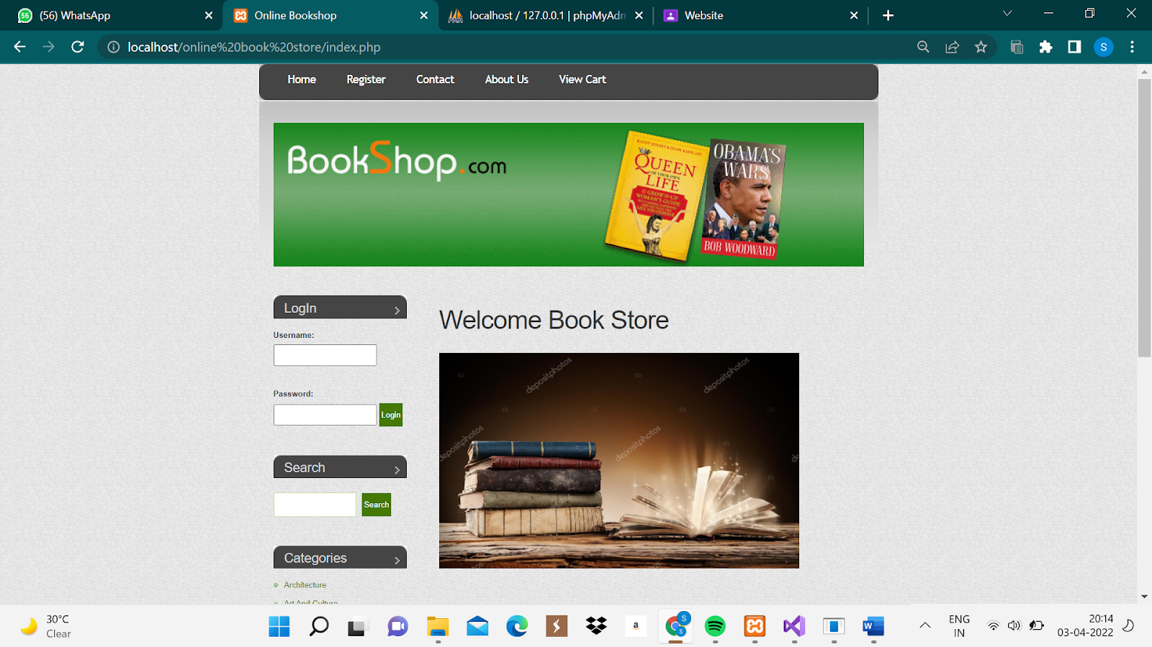
OUTPUT-USER HOME PAGE

Slide 9
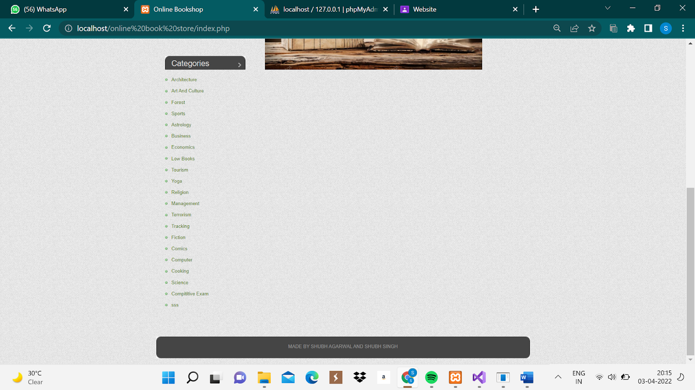
OUTPUT-USER HOME PAGE

Slide 10
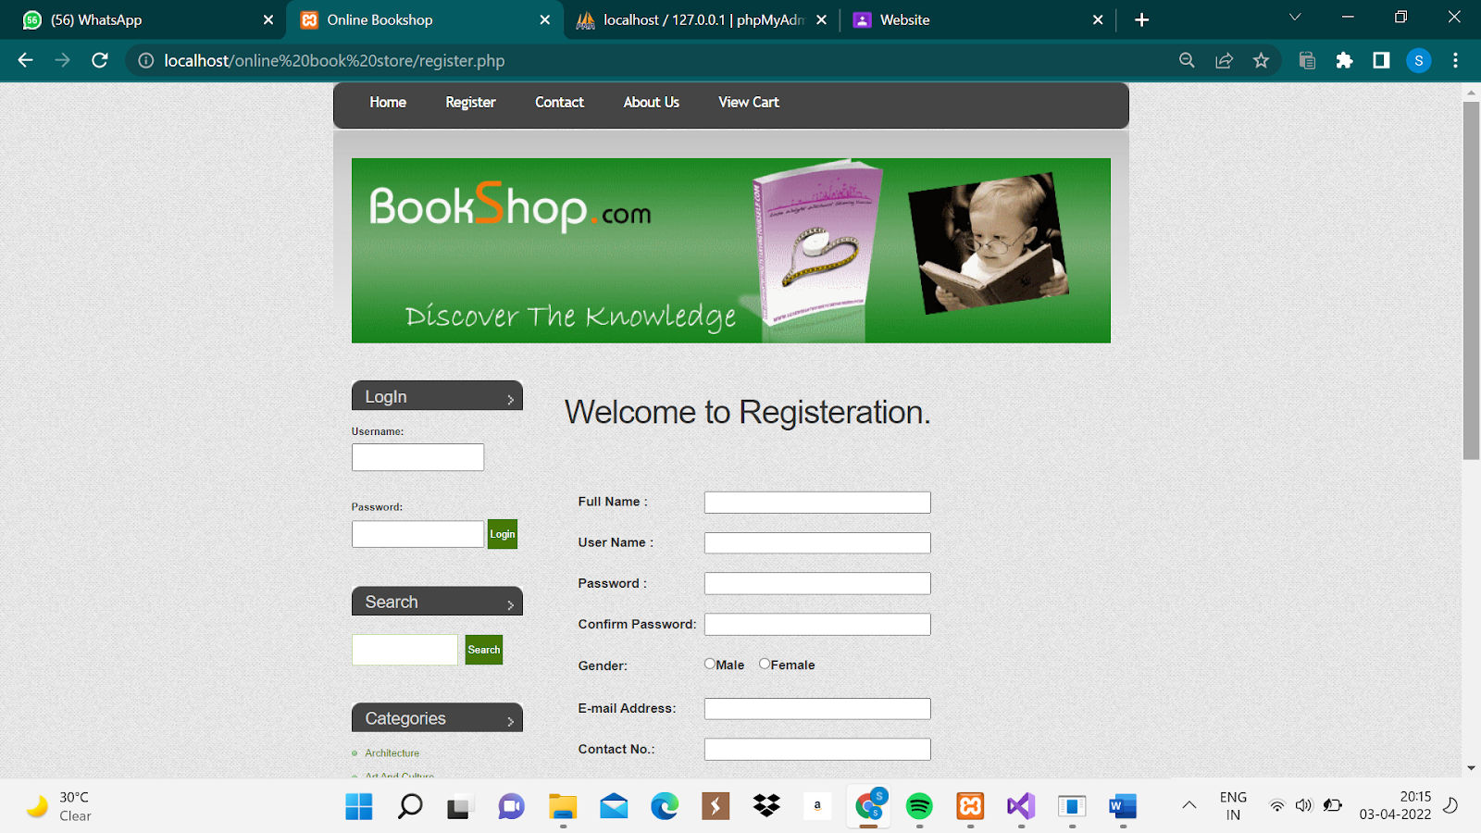
REGISTER SCREEN

Slide 11
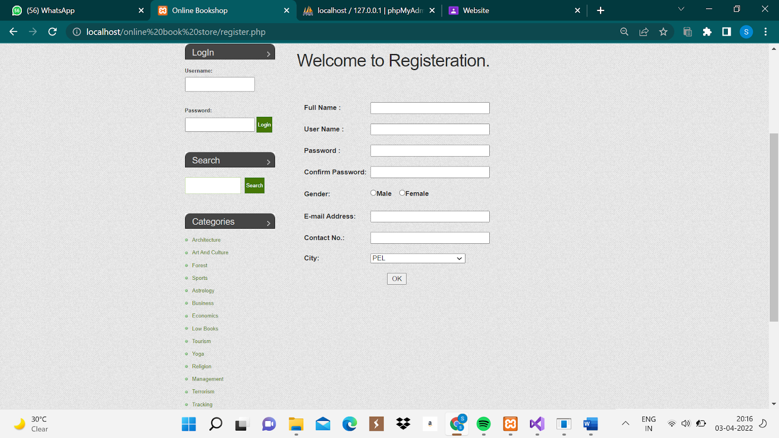
REGISTER SCREEN

Slide 12
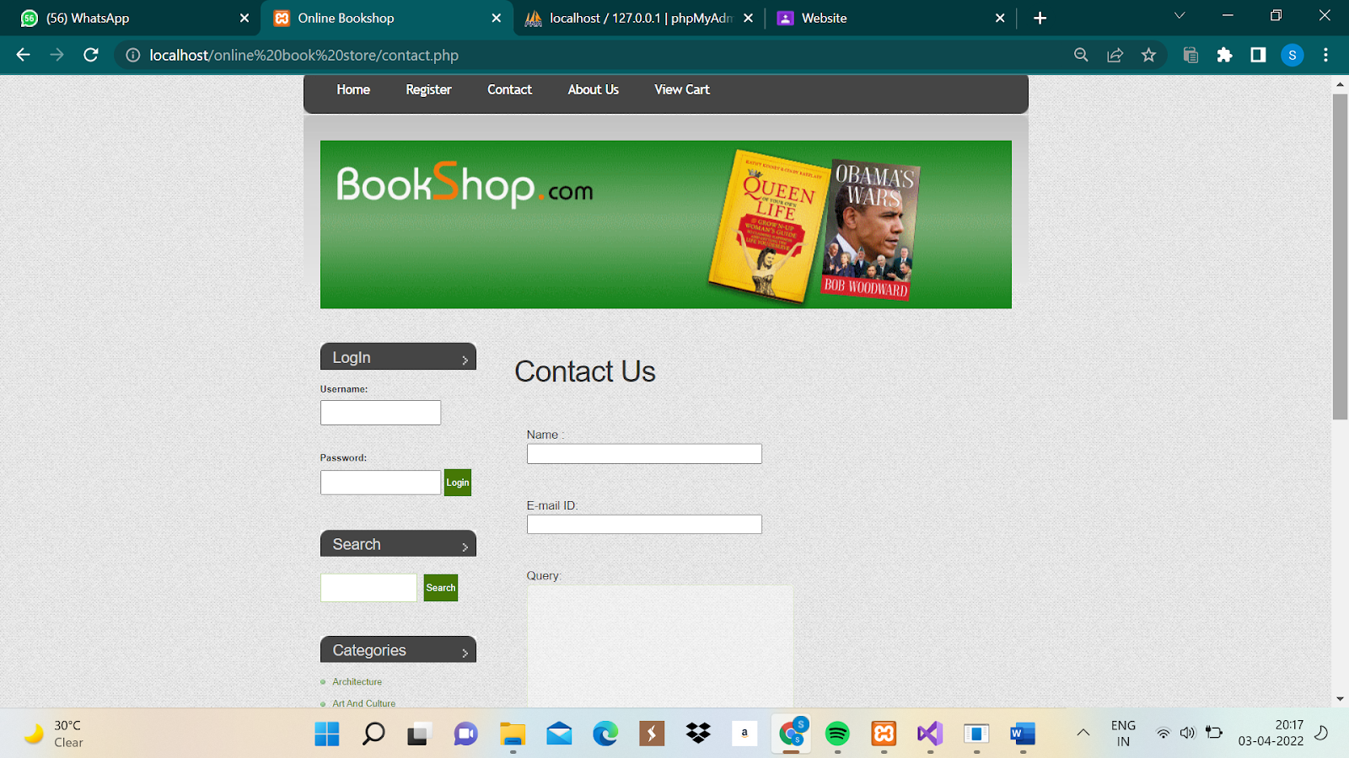
CONTACT US

Slide 13
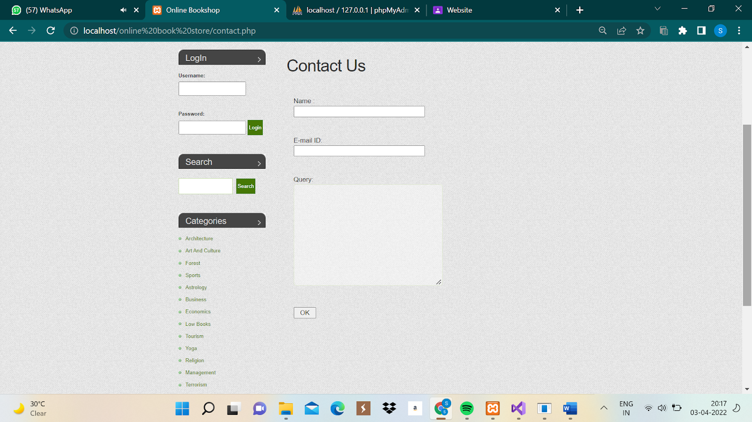
CONTACT US

Slide 14
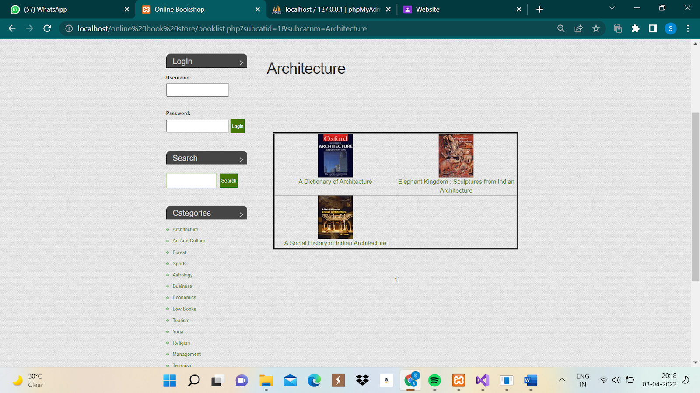
ARCHITECTURE BOOK CATEGORY

Slide 15
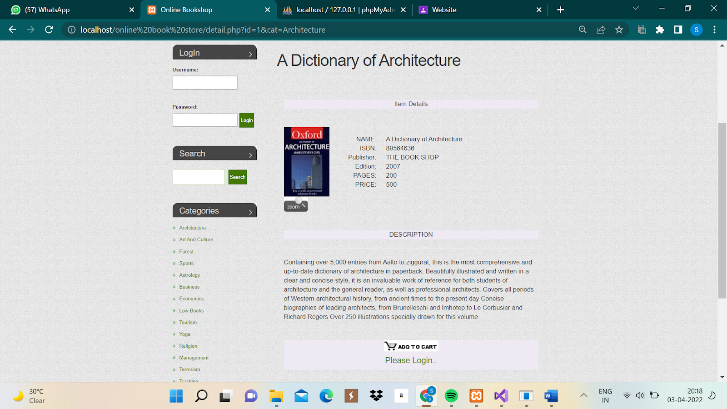
A DICTIONARY OF ARCHITECTURE

Slide 16
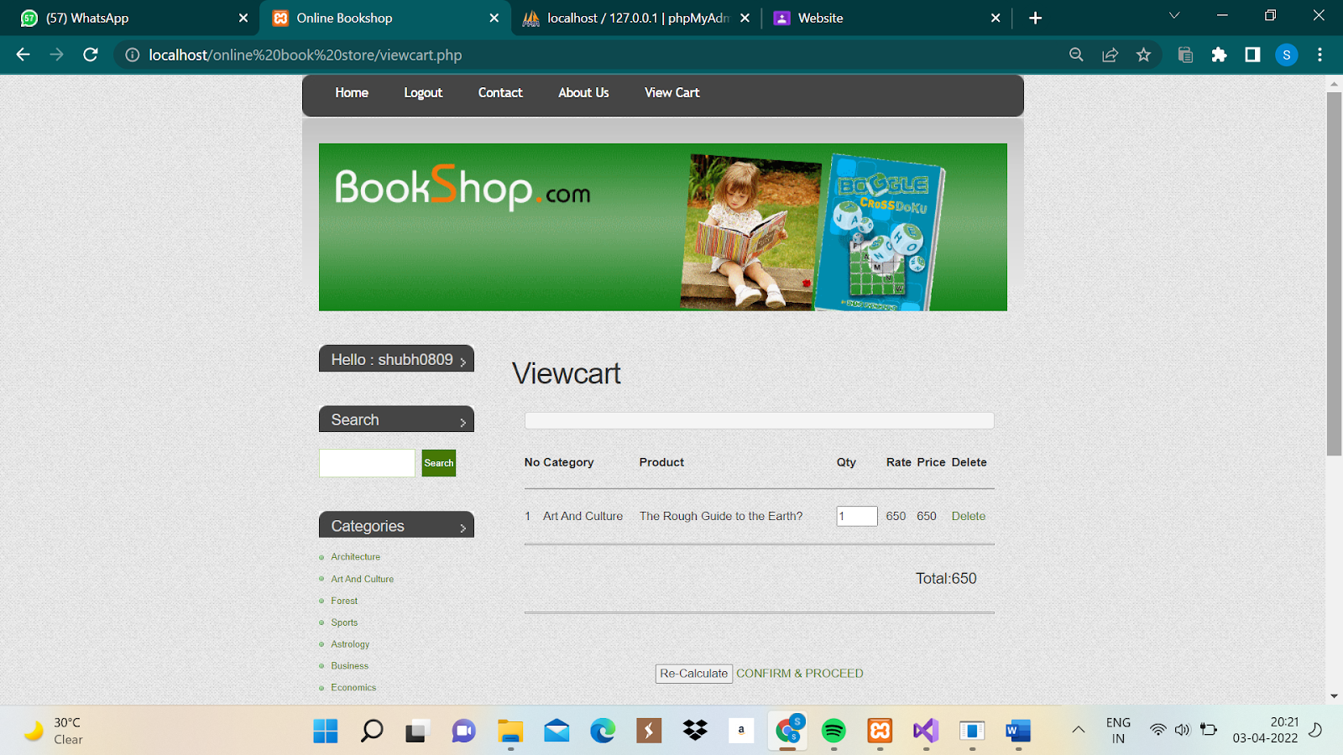
VIEWCART

Slide 17
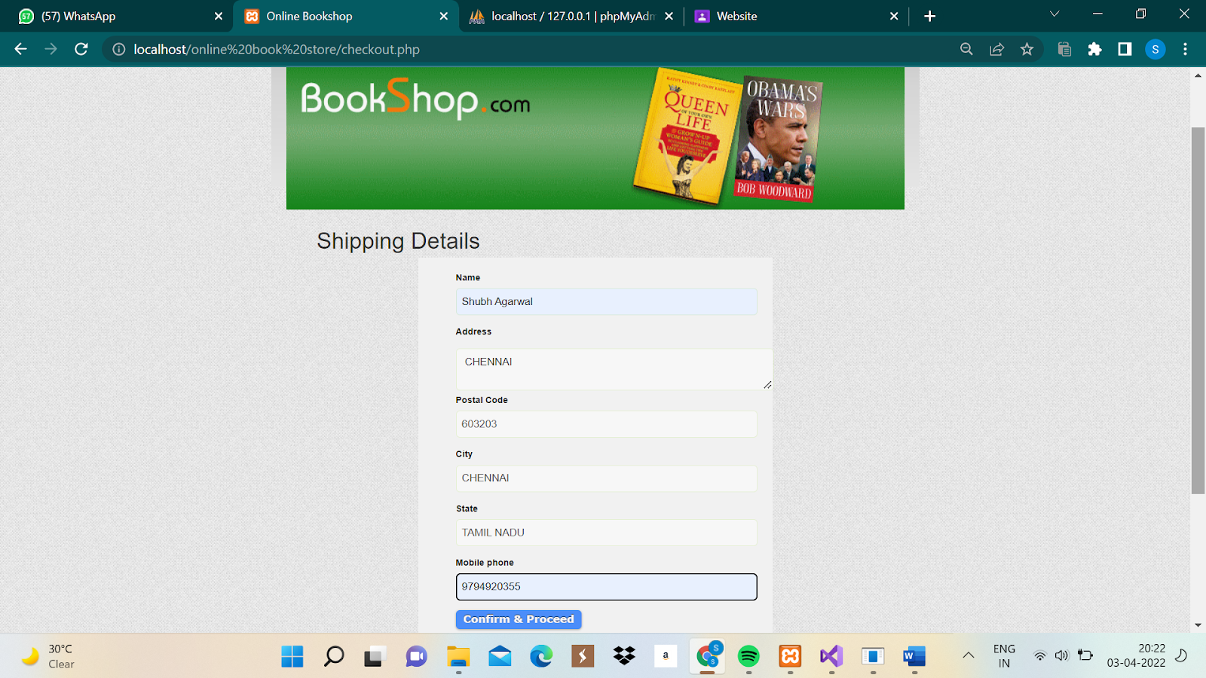
SHIPPING ADDRESS

Slide 18
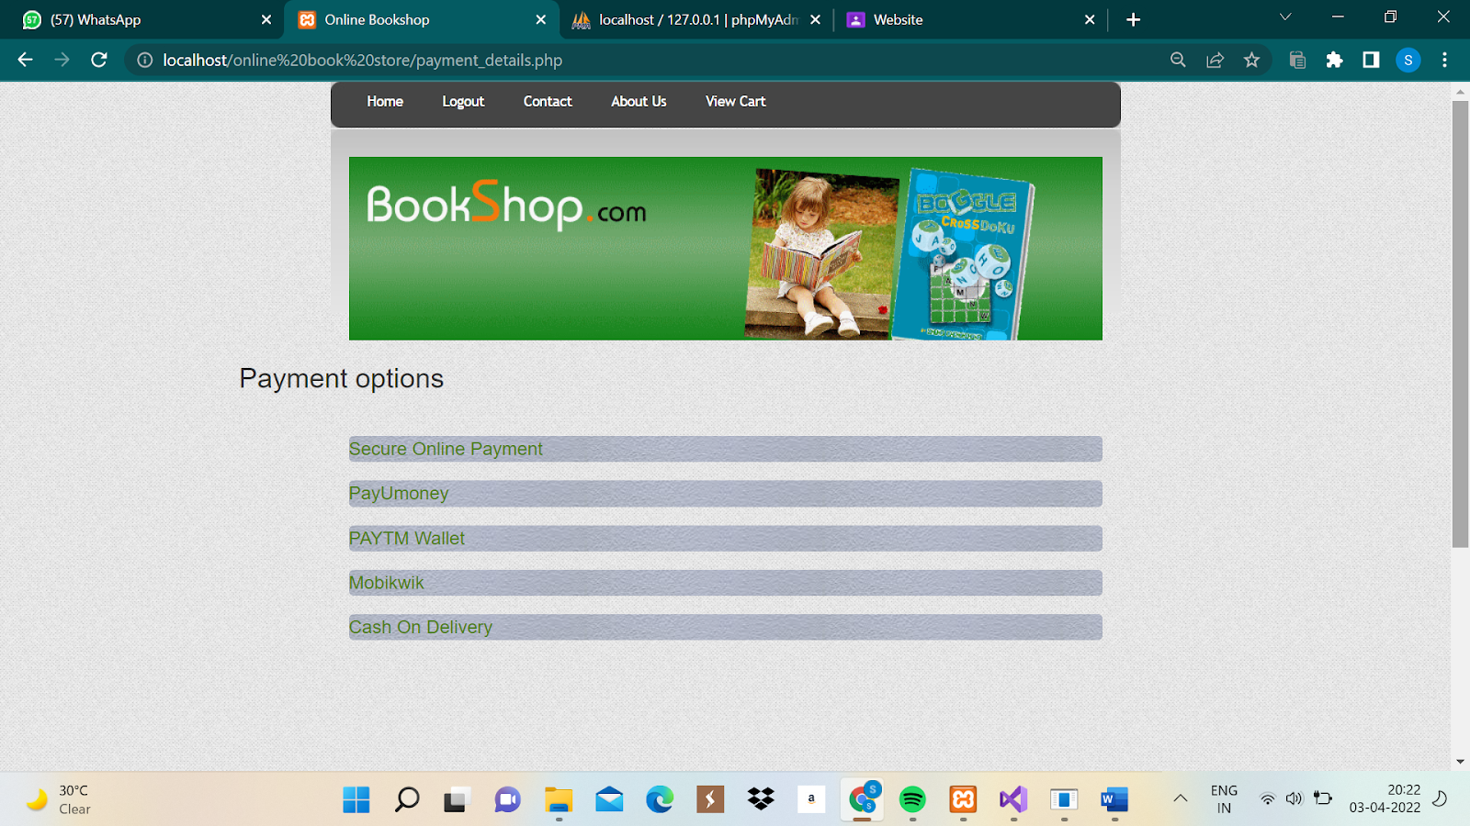
PAYMENT OPTIONS

Slide 19
THANK YOU
-BY SHUBH SINGH (RA1911042010124)
-BY SHUBH AGARWAL (RA1911042010122)

